Slide 1
Restaurant Automation System

Slide 2
Introduction
The aim of this project is to design, build and test a RESTURANT AUTOMATION SYSTEM which can handle the ordering process; in particular the flow and storage of order information.

Slide 3
Project Phases
All projects phases are divided into Sprints
All Sprints together make up Project Life Cycle
Each Sprint is marked by completion of Submission of code and user stories.
Identify the primary software project phases

Slide 4
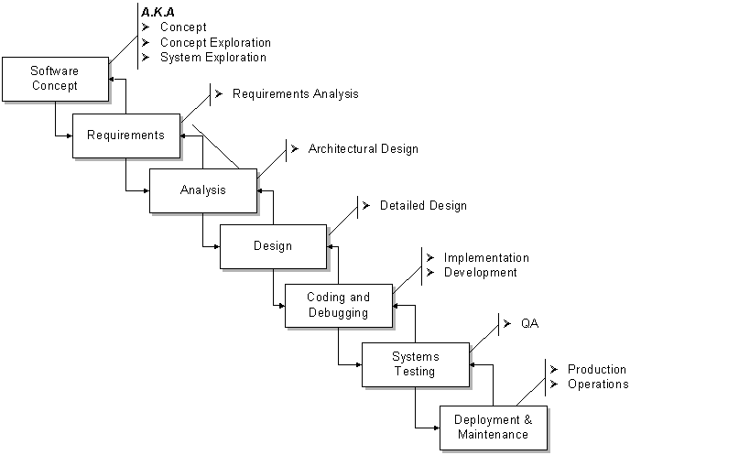
Software life cycle

Slide 5
Technical Fundamentals
Requirements
Analysis
Design
Construction
Quality Assurance/Test cases
Deployment

Slide 6
Primary Modules of the Project
Administrator(Manager)
Chef
User(Customer)

Slide 7
Objectives
Primary
A means to persist data across each interface.
Interface for displaying pending orders.
Interface for managing menus, menu items and ingredients.
Interface for reservations.
Payment options
Interface for Table management.
Secondary features – Future Scope
Customer interface is capable of running on a variety of different handheld devices.
Management interface can be accessed over the Internet.
Manager can view past orders in the form of graphs.
Automatic deductions of stock levels upon order submission
Manager can administer the waiters.
Customer interface can provide alerts when orders have been completed.

Slide 8
Project category
Restaurant Automation System (RAS)" is an application to restaurant management. The services that it facilitates are food ordering, reservation table management, customer, waiter and chef information management.

Slide 9
Roles and Responsibilities
Chef:
Prepares today’s menu.
Get and Set Order status updates.
Manager:
Reserves seat.
Manages stock.
Add a new employee(chef or waiter)
Delegates authority
Customer:
Place orders
Get Updates

Slide 10
Internal Flow of Modules
Manage ingredients/menu items/menus/waiters
Intent: Allow objects to be added to the data store, removed from it, or modified.
Flow of Events: Entry of object specific data, submitted via the GUI for addition. Similar process for modifications. Removals done by means of a view of all current objects in the data store followed by clicking the corresponding "Delete" button.

Slide 11
Receive service notifications
Intent: Be notified of real-time order preparation completion.
FOE: Once the chef has marked an order as completed, a notification will be sent to the customer who submitted the order, notifying him/her to collect the order.

Slide 12
View available menu items
Intent: Display every available menu item to the customer so that the customer can be informed of the choice they have.
FOE: No user interaction. Selection boxes updated at regular intervals to reflect what the data store is showing as available

Slide 13
Submit order
Intent: Send a new order to the data store.
FOE: Entry of table number and menu items with quantities and notes. Then submitted by means of the GUI.

Slide 14
View pending orders
Intent: Display uncompleted orders in chronological order.
FOE: No user interaction. The GUI updates the data view at a set interval to fetch new orders from the data store.

Slide 15
Remove pending orders
Intent: Modify the GUI so that orders which have been completed are no longer in view.
Flow of Events (FOE): Choose which order to remove by clicking the corresponding "Completed" button. This tells the GUI to remove the data from view, marks the Order object as complete in the data store and sends an alert to the customer who submitted the order if alerts are turned on.

Slide 16
Context diagram
Chef
Remove completed orders
Submit Order
Customer
RAS Application
Get Pending orders
Get Service Alerts
Edit menu items/ingredients/menus
View Statistics/accounts
Execute Query
Return Result Set
MANAGER
Database

Slide 17
Tools/platform and technology used
Front End:-JAVA
User friendly
GUI
Separation of work (designing & coding)
Written once run anywhere
Back End:- MySQL
Security
Performance
Scalability
Reliability
Support RDMS concepts
Large database and space management.
Many concurrent database users.
High transaction processing requirement

Slide 18
Future Scope
There are a number of ways that this project can be further enhanced. That would include the addition of some more features like:
Graphical representation could be added to view the report
An option to modify the existing order could also be added.
These features were not added due to time constraints.

